Slide 1
Azure Data Storage:

Slide 2
Agenda
Azure Data Lake Storage.
Azure Blob Storage.
Azure SQL Database.

Slide 3
Azure Data Lake Storage.
Azure Data Lake Storage (ADLS) is a highly scalable and secure data storage solution provided by Microsoft as part of its Azure cloud platform. It's designed to store and process vast amounts of structured, semi-structured, and unstructured data. ADLS is often used for big data analytics, data lakes, and data warehousing. Here's a breakdown of its key features:
Key Features:
Scalability: ADLS can handle exabytes of data and is designed to scale as your data grows, making it suitable for big data applications.
Hierarchical Namespace: Unlike traditional object storage systems, ADLS supports a hierarchical namespace, which organizes data into directories and subdirectories. This makes it more efficient for managing large datasets.
High Availability and Durability: Data in ADLS is replicated across multiple locations in a region, ensuring high availability and durability.
Security and Compliance:
Data Encryption: Both at rest and in transit.
Access Control: ADLS integrates with Azure Active Directory (AAD) for authentication and provides fine-grained access control using role-based access control (RBAC) and Access Control Lists (ACLs).
Integration with Azure Ecosystem: ADLS integrates seamlessly with other Azure services such as Azure Data Factory, Azure Databricks, Azure Synapse Analytics, and HDInsight, allowing for comprehensive data engineering and analytics workflows.
Optimized for Analytics: ADLS is optimized for large-scale analytics workloads, including batch, real-time, and interactive queries using tools like Apache Spark and Hadoop.

Slide 4
Azure Data Lake Storage.
Types of Azure Data Lake Storage:
ADLS Gen1: The first version of Data Lake Storage. It’s built specifically for big data analytics but is now considered legacy.
ADLS Gen2: Combines the capabilities of Azure Blob Storage with those of a hierarchical namespace. It’s optimized for performance, costs, and integration with analytics services.
Common Use Cases:
Big Data Analytics: Storing and analyzing massive datasets from various sources.
Data Lake: Serving as a centralized repository for all enterprise data.
Machine Learning and AI: Storing and processing large amounts of data used for training models.
Data Warehousing: Feeding data into modern cloud data warehouses like Azure Synapse.

Slide 5
Azure Blob Storage
Azure Blob Storage is a service provided by Microsoft Azure designed to store large amounts of unstructured data, such as text or binary data. It is highly scalable and cost-effective, making it ideal for applications that require vast amounts of storage for data that does not conform to a specific data model or schema.
Key Features:
Types of Blobs:
Block Blobs: Used to store text and binary data. Block blobs are ideal for storing files, documents, images, and media.
Append Blobs: Optimized for append operations, commonly used for logging purposes.
Page Blobs: Designed for frequent read/write operations, often used for virtual machine disks and large datasets.
Scalability: Blob storage can handle petabytes of data, making it a great option for high-scale, cloud-native applications.
Storage Tiers: Azure Blob Storage provides different tiers for cost optimization based on data access patterns:
Hot: Optimized for frequently accessed data.
Cool: Designed for infrequently accessed data with lower storage costs but higher access costs.
Archive: The lowest-cost option for long-term data storage, used for data that is rarely accessed and has flexible retrieval times.
High Availability and Durability: Data in Blob Storage is replicated across multiple locations for redundancy, ensuring high availability and durability. There are multiple replication options:
Locally Redundant Storage (LRS): Copies data within the same data center.
Zone-Redundant Storage (ZRS): Replicates data across multiple availability zones within a region.
Geo-Redundant Storage (GRS): Replicates data to a secondary region for disaster recovery.
Read-Access Geo-Redundant Storage (RA-GRS): Allows read access to the secondary copy in the event of a primary failure.

Slide 6
Azure Blob Storage
5. Security:
Encryption: Data is encrypted both at rest and in transit.
Access Control: Provides shared access signatures (SAS), role-based access control (RBAC), and integration with Azure Active Directory (AAD) for secure authentication and authorization.
Integration with Azure Ecosystem: Blob Storage integrates with other Azure services like Azure Data Lake, Azure Machine Learning, Azure Media Services, and Azure Data Factory, making it a key component of data pipelines and analytics workflows.
Cost-Efficiency: Blob Storage is cost-effective, especially when combined with its tiering options. Users can move data between hot, cool, and archive tiers based on usage patterns, reducing costs.
Common Use Cases:
Backup and Restore: Blob Storage is often used to store backup data due to its scalability and security.
Big Data Analytics: Blob Storage can hold large datasets for processing by data analytics services like Azure Databricks or HDInsight.
Content Delivery: Store media files like videos, audio, and images to deliver via content delivery networks (CDNs).
Disaster Recovery: Geo-redundant options make it a popular choice for disaster recovery scenarios.
Data Archiving: Long-term data retention with the Archive tier at a significantly lower cost.

Slide 7
Azure SQL Database.
Azure SQL Database is a fully managed, cloud-based relational database service provided by Microsoft Azure. It is built on the SQL Server engine, offering robust capabilities for handling transactional, relational, and analytical workloads. Azure SQL Database is a Platform as a Service (PaaS) solution, meaning that it handles most database management tasks such as patching, backups, scaling, and high availability, allowing users to focus more on application development and less on administrative tasks.
Key Features:
Fully Managed Service: Microsoft handles maintenance, backups, patches, and database optimization, ensuring minimal downtime and seamless performance upgrades.
High Availability: Azure SQL Database offers built-in high availability (HA) with automated failover and redundancy across different regions or zones, ensuring your data is always available.
Scalability:
Elastic Pools: Azure SQL allows you to scale out by placing multiple databases in an elastic pool, sharing resources dynamically based on demand.
Vertical Scaling: You can easily scale up or down the compute power (vCores) and storage of individual databases to meet changing needs.
Performance Tuning:
Intelligent Performance: Features such as query performance insights, automatic tuning (index recommendations), and automatic plan correction ensure optimized performance with minimal manual intervention.
In-Memory OLTP: For highly transactional workloads, In-Memory OLTP allows faster transaction processing and lower latency.

Slide 8
Azure SQL Database.
5. Security:
Encryption: Azure SQL Database supports Transparent Data Encryption (TDE) for data at rest, and encryption for data in transit using SSL/TLS.
Advanced Threat Protection: Real-time monitoring and detection of unusual activities, potentially harmful queries, or security vulnerabilities.
Access Control: Integration with Azure Active Directory (AAD) for identity-based access, as well as role-based access control (RBAC) for fine-grained permissions.
Data Masking: Dynamic data masking to limit the exposure of sensitive data.
Backup and Recovery:
Automated Backups: Azure SQL automatically performs full, differential, and transaction log backups, allowing point-in-time recovery.
Long-term Retention: Backups can be stored for up to 10 years, meeting long-term retention requirements for compliance.
Global Availability: Azure SQL Database is available in multiple regions worldwide, allowing users to deploy databases close to their customers for improved latency and compliance with local data residency regulations.
Integration with Azure Services: It seamlessly integrates with other Azure services, such as Power BI for analytics, Azure Data Factory for ETL processes, Azure Functions for serverless computing, and more.

Slide 9
Azure SQL Database.
Deployment Options:
Single Database: Best for applications that require isolated databases with predictable workloads. Each database is managed individually and can be scaled independently.
Elastic Pools: Ideal for multi-tenant applications, elastic pools allow you to host multiple databases that share a set of resources. This enables cost-efficient resource management for unpredictable or fluctuating workloads.
Managed Instance: This is a hybrid deployment model that provides near-complete SQL Server compatibility, including SQL Agent, cross-database querying, and more. It is designed to offer more control and features similar to those available in an on-premise SQL Server but with the benefits of a fully managed service.
Pricing Models:
Azure SQL Database offers two main purchasing models:
DTU-Based Model: Based on a blend of compute, storage, and I/O resources that are offered at different pricing tiers (Basic, Standard, Premium).
vCore-Based Model: Offers more flexibility in choosing compute and storage resources. It provides independent scaling of compute and storage and is often more suitable for larger or more complex workloads.

Slide 10
Azure SQL Database.
Common Use Cases:
OLTP (Online Transaction Processing): Ideal for business applications requiring fast query response times and high reliability for transactions.
SaaS Applications: Frequently used by ISVs (Independent Software Vendors) to build multi-tenant SaaS applications, leveraging features like elastic pools.
Reporting and Analytics: Integration with reporting tools like Power BI allows users to perform real-time analytics on relational data stored in Azure SQL Database.
Disaster Recovery: With geo-replication and automatic failover, Azure SQL Database provides strong disaster recovery solutions.
Differences from SQL Server:
While Azure SQL Database and SQL Server share the same underlying SQL Server engine, the key difference is that Azure SQL Database is a fully managed cloud service, while SQL Server can be deployed on-premises or in Azure virtual machines (IaaS). This makes Azure SQL Database ideal for cloud-native applications that don’t require the full feature set of SQL Server or that can benefit from its PaaS nature

Slide 11
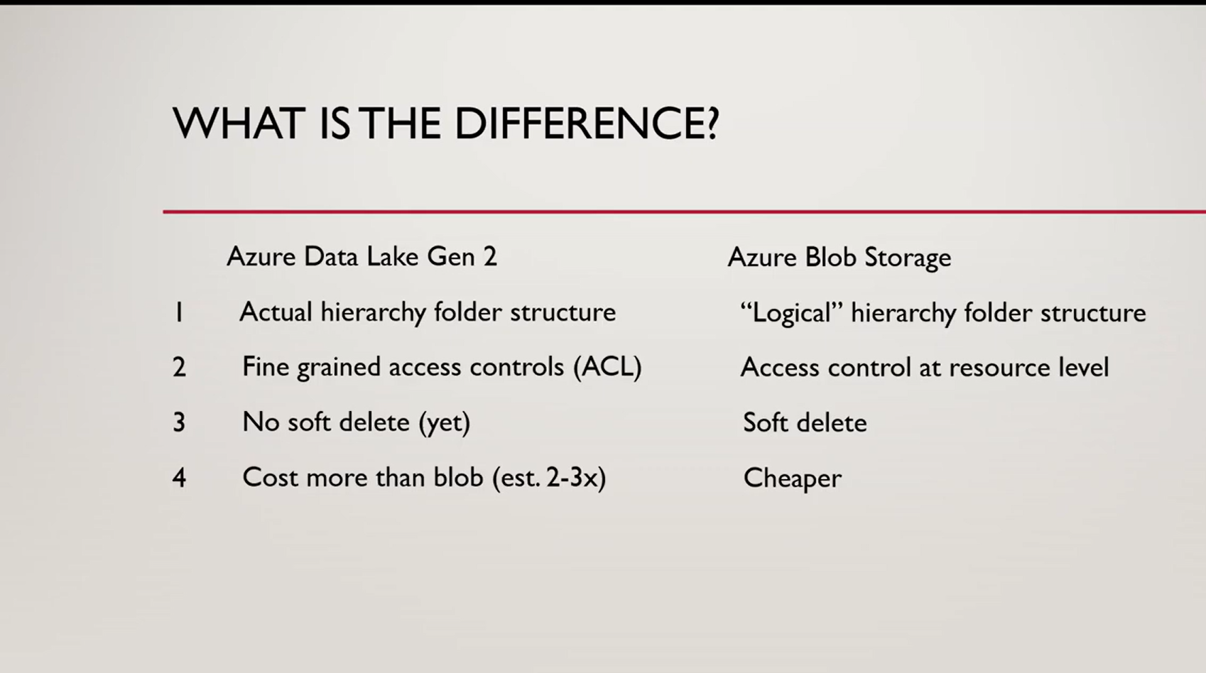
Difference between Azure

Slide 12
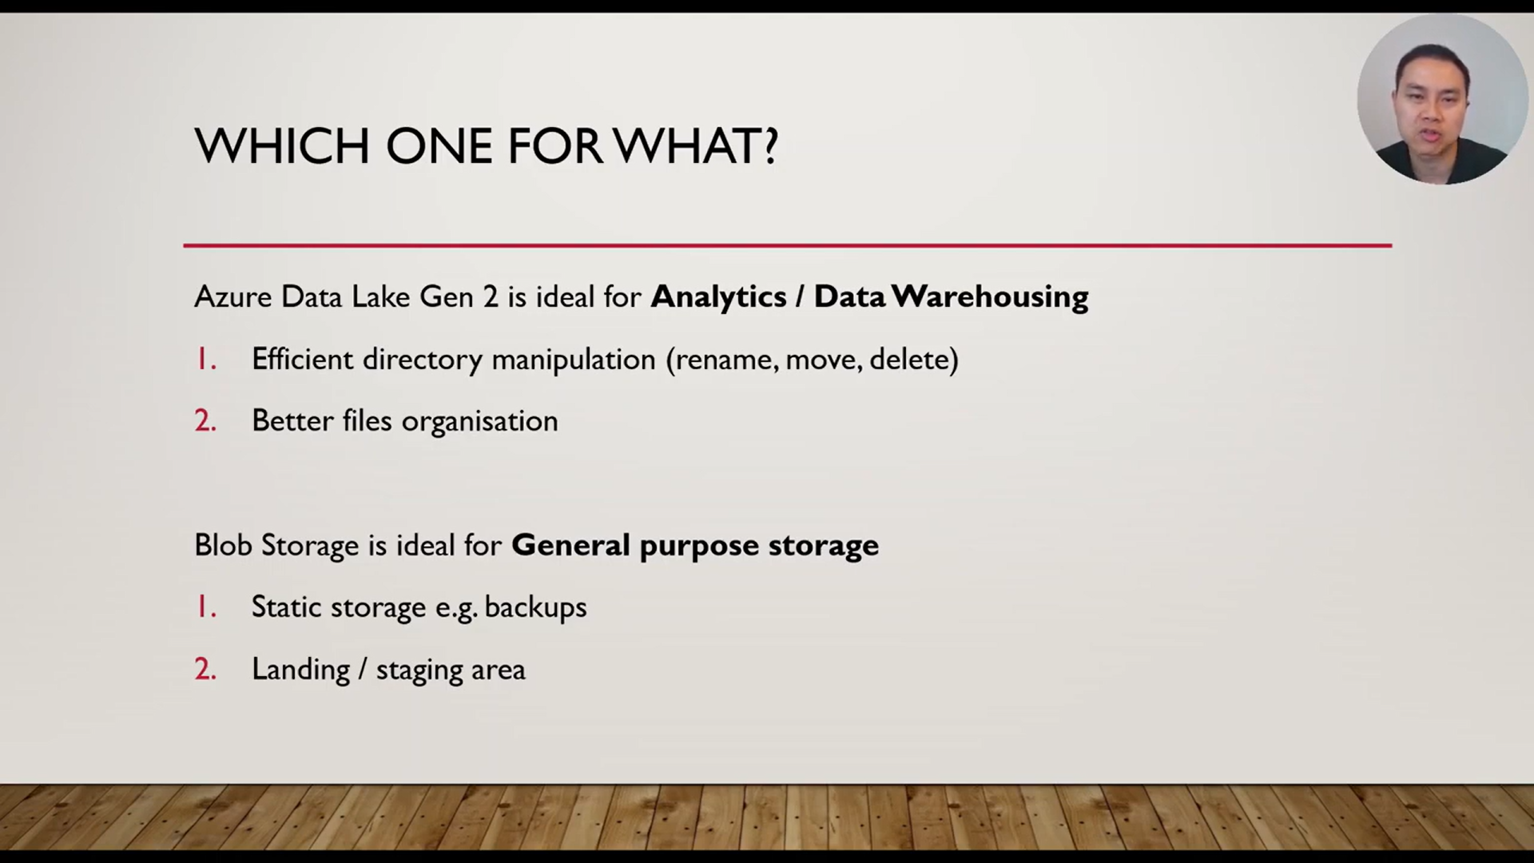
Difference between Azure

Slide 13
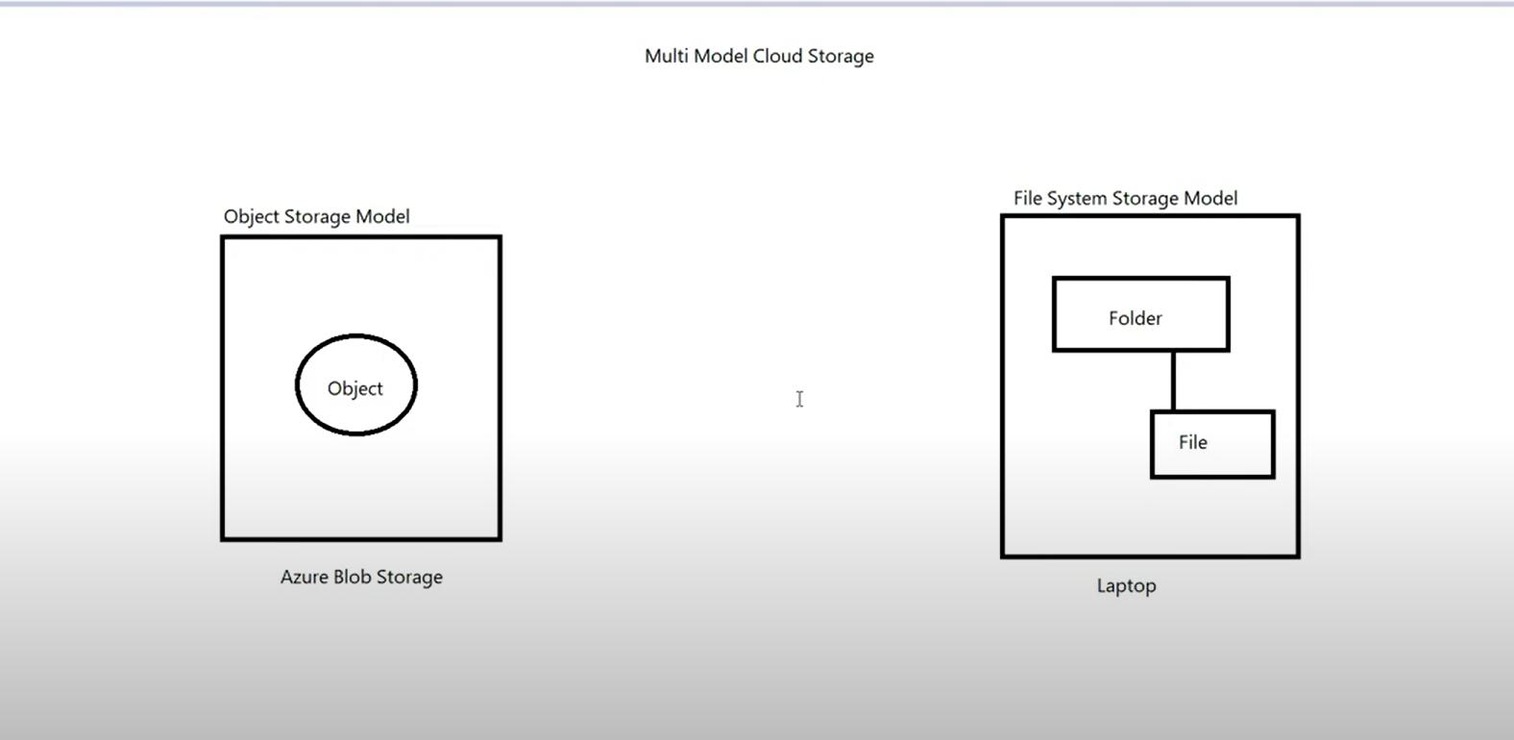
Various storage Models

Slide 14
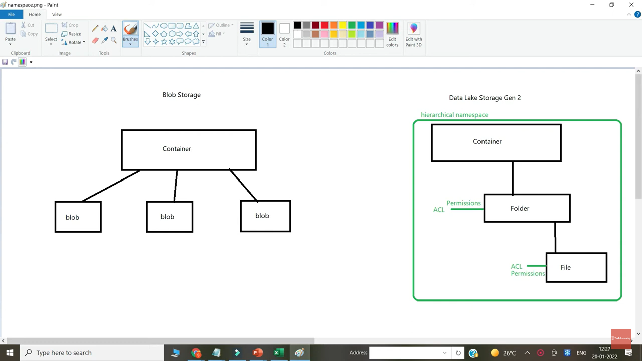
Various storage Models

Slide 15
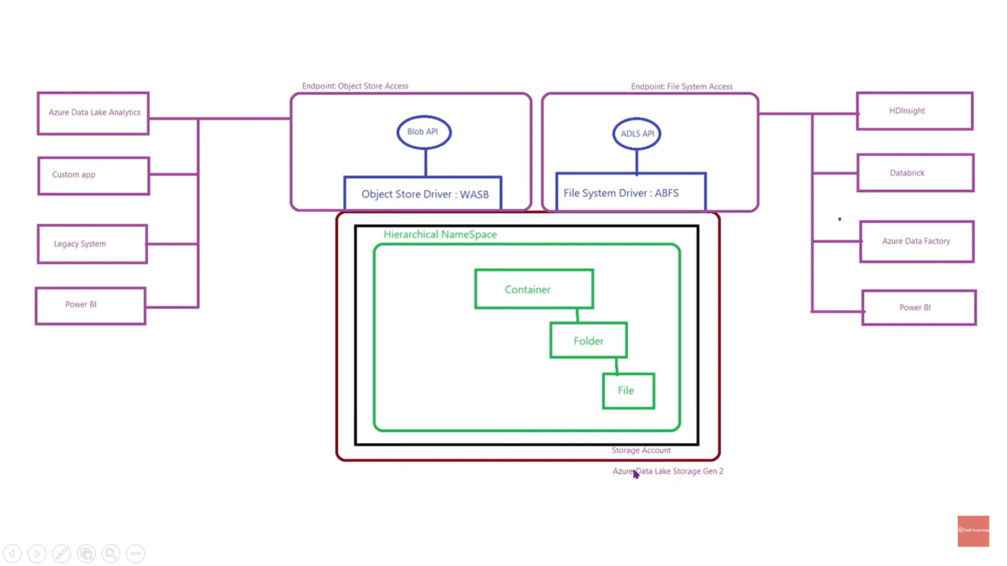
Various storage Models
For bigdata analytics or Hadop Server we use

Slide 16
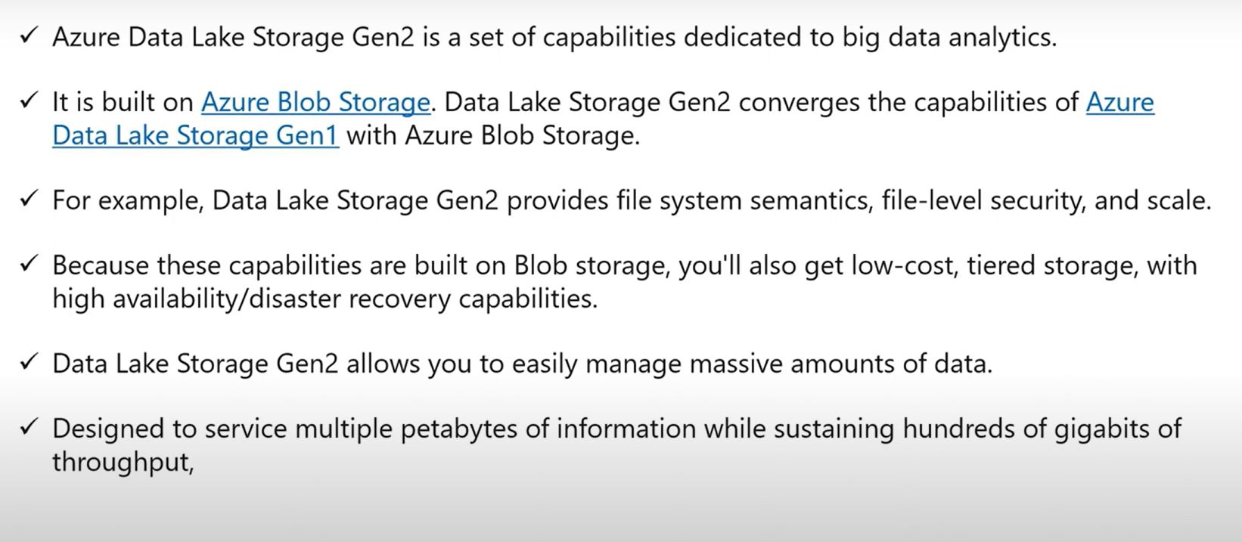
Various storage Models

Slide 17
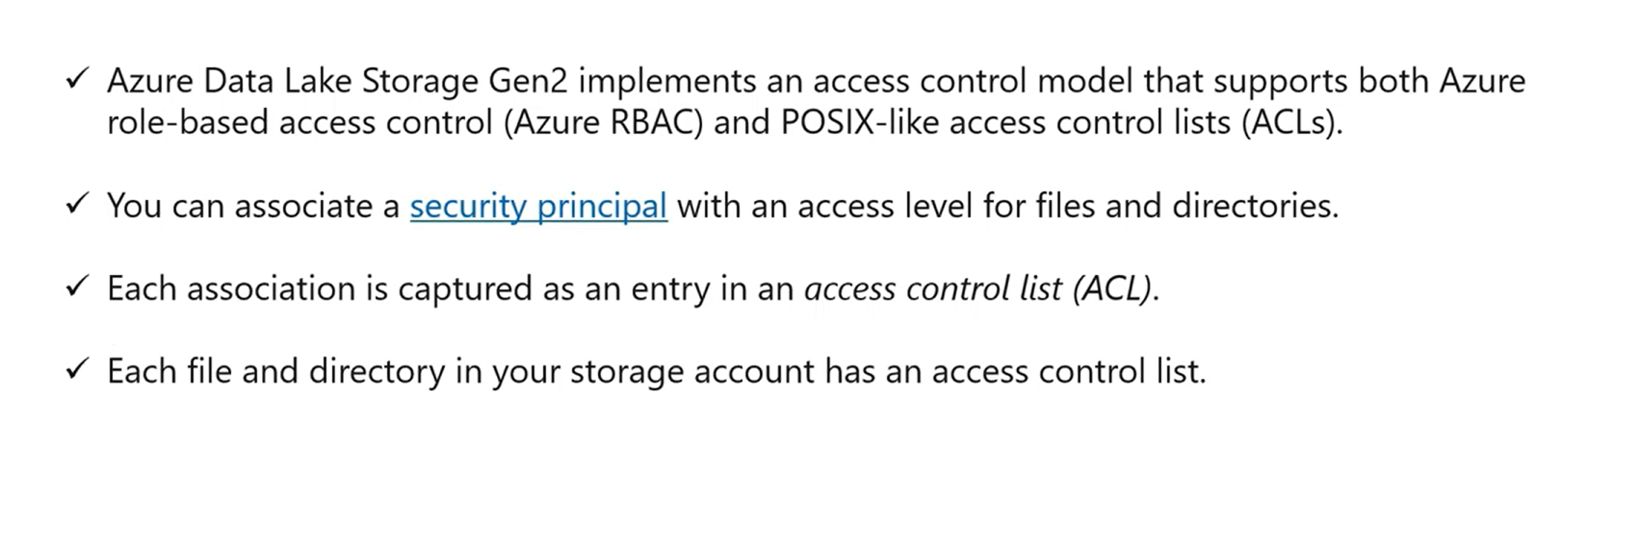
Various storage Models

Slide 18
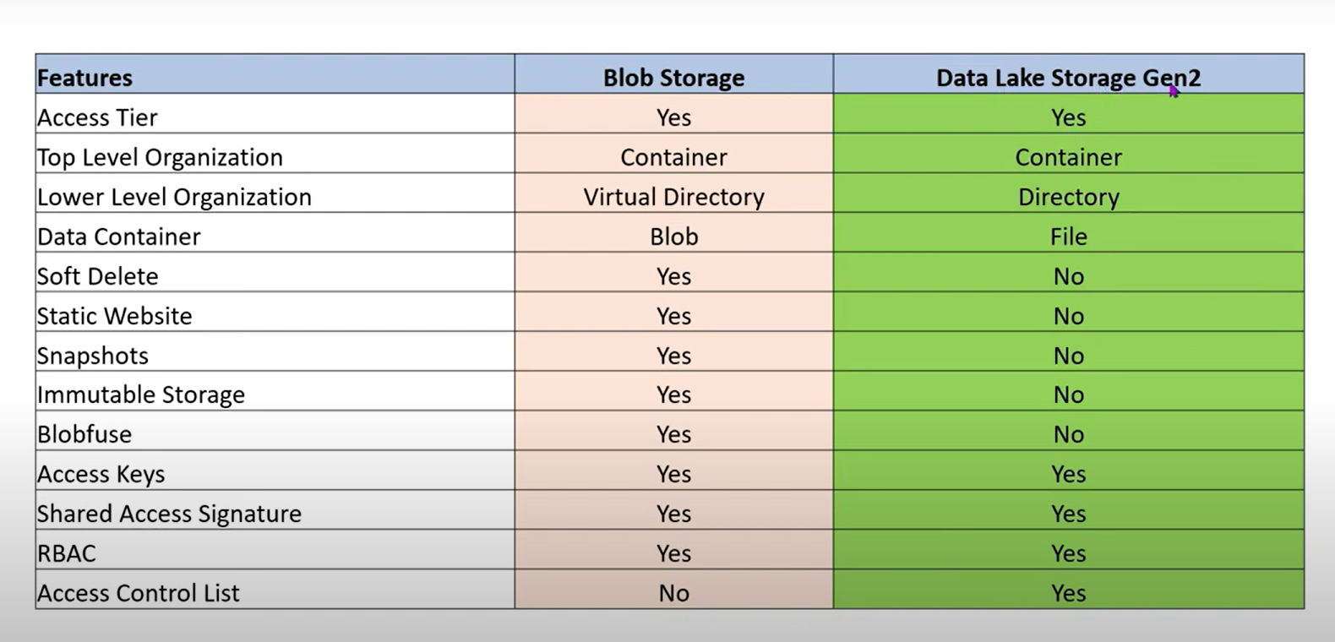
Difference between datalake and Blob storage

